Slide 1
Transaction Cost Issues in Agriculture and Various Markets The Most Important Lesson!!

Slide 2
Often Ignored in Neoclassical Economics
The cost of transacting: Applications Rural markets, taxation, thin stock markets
Getting one party to a transaction or contract to deliver what is promised
Measurement Problems
Information Problems
Adverse Selection Problem
Moral Hazard Problem (Ex Ante and Ex Post)

Slide 3
Contracts are established between sellers and buyers of any product or service
Is there an optimal form?
Consider the problem of contracting between owner of labor and land inputs in agriculture

Slide 4
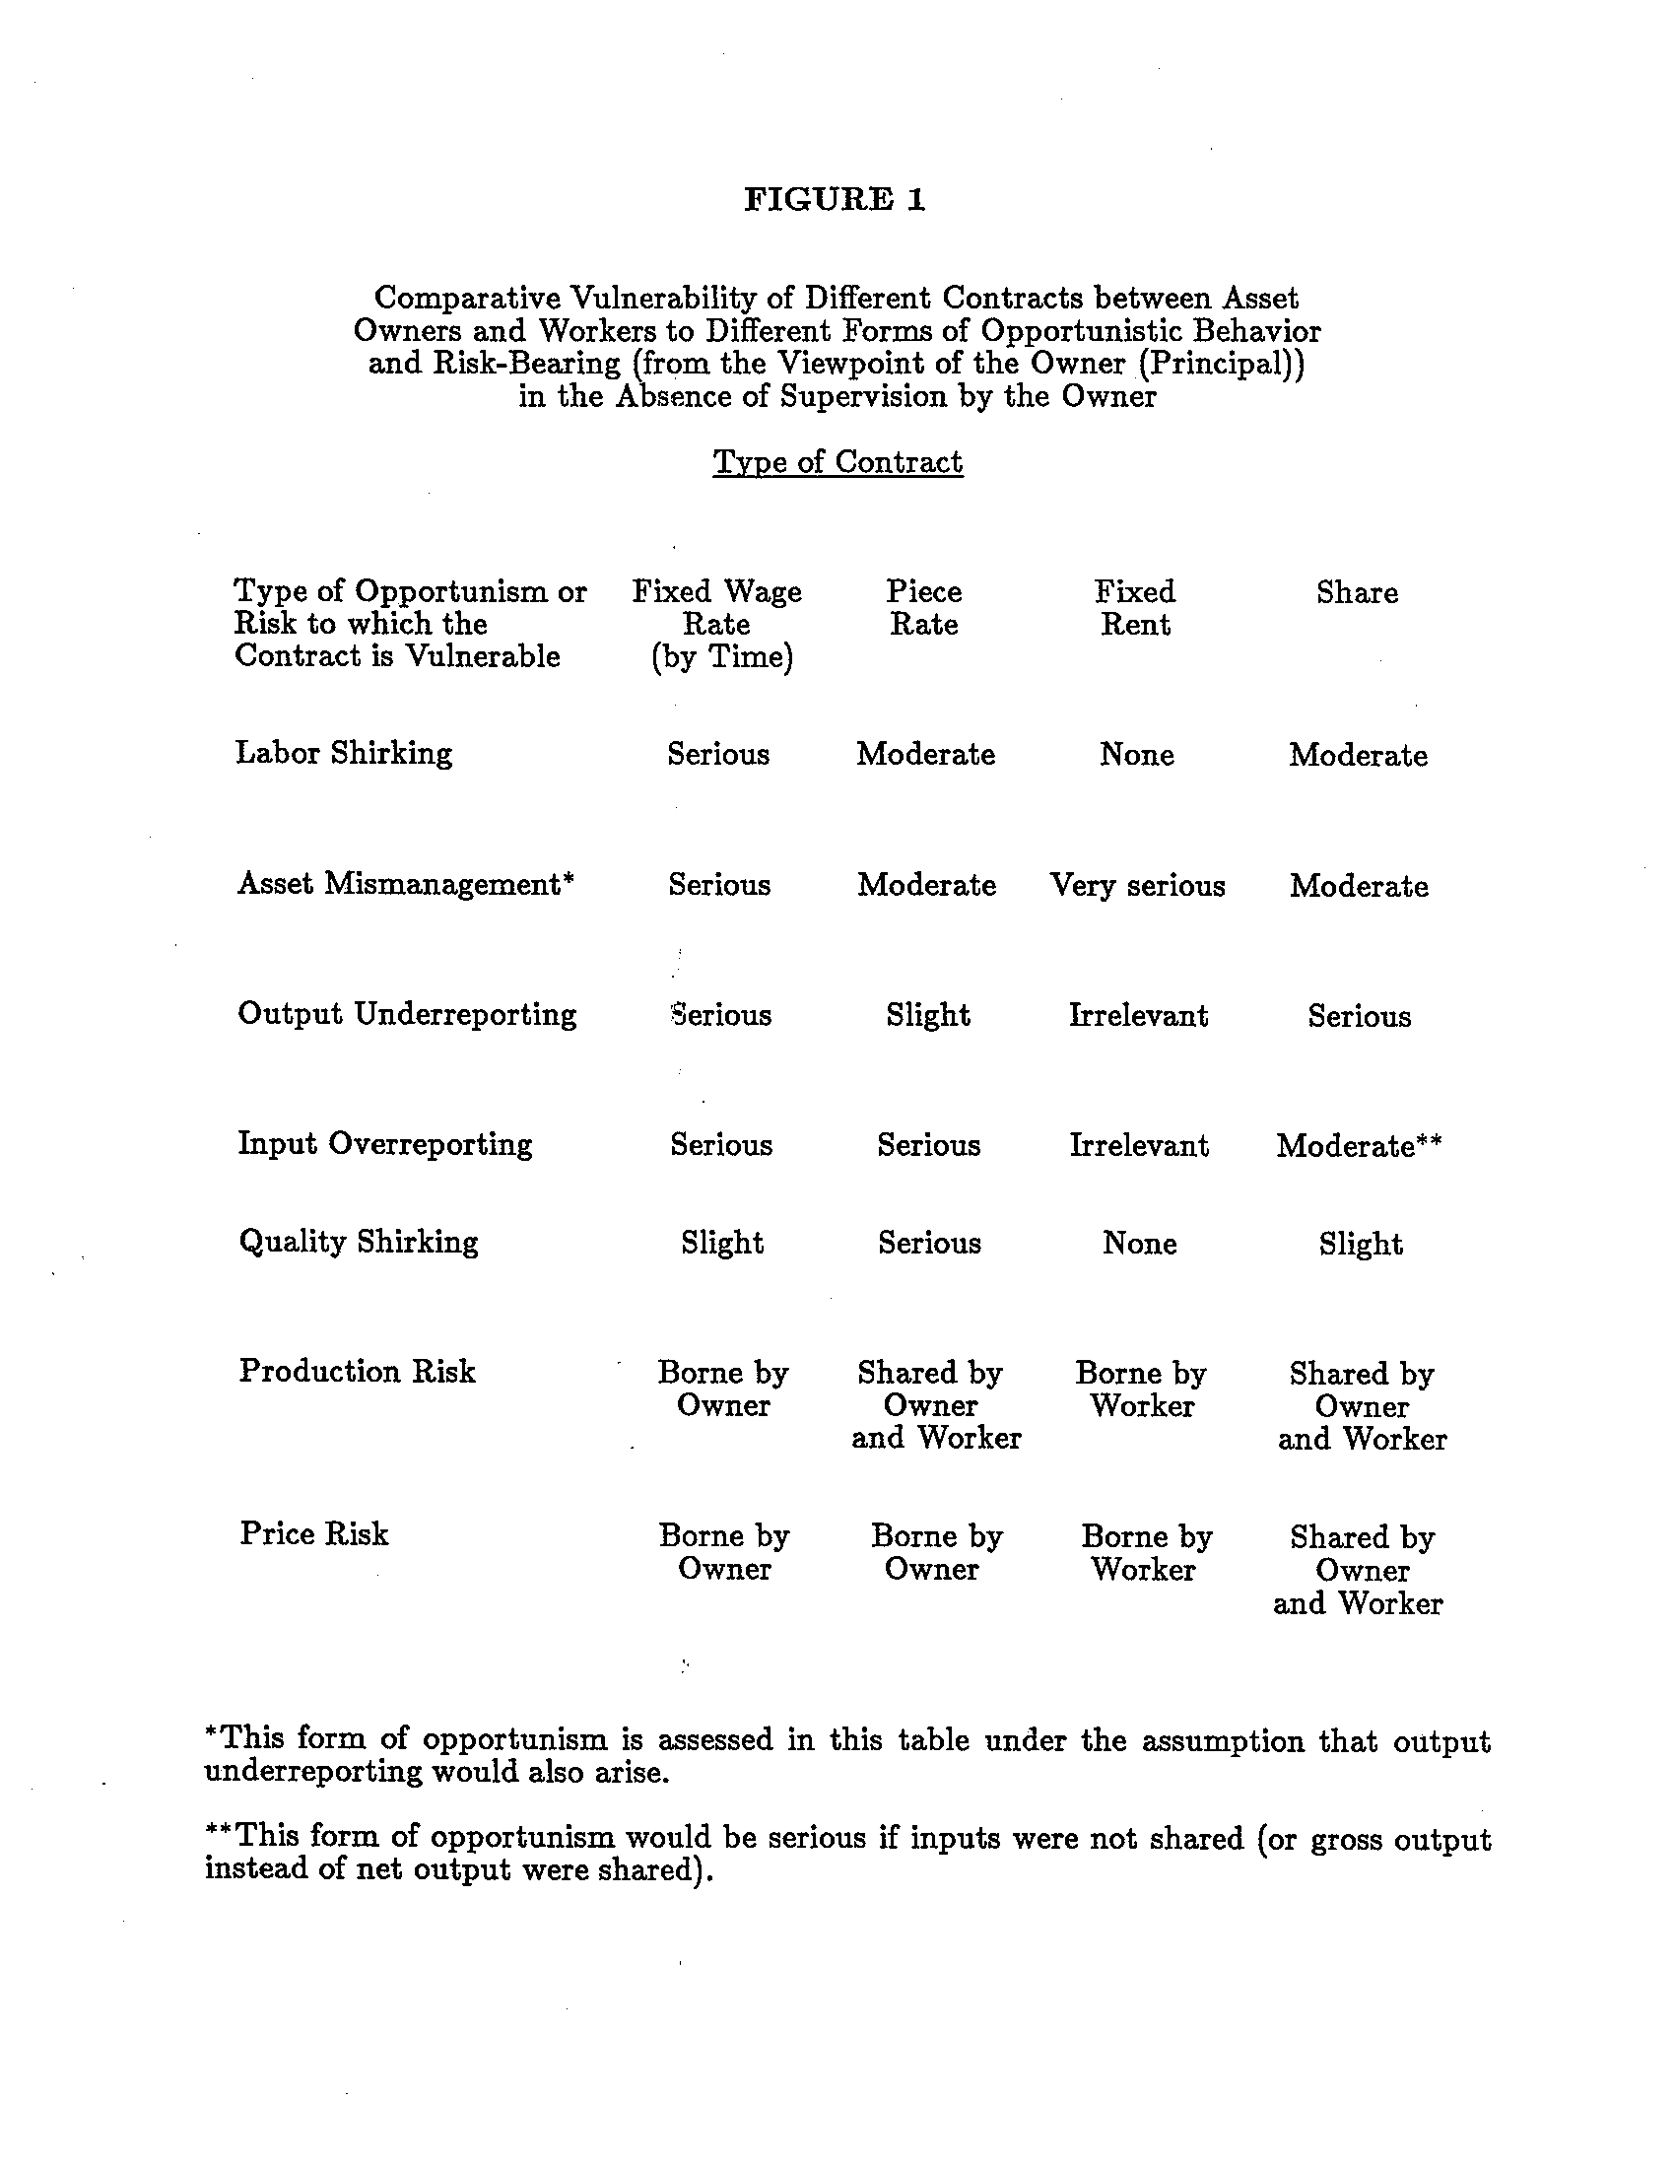

Slide 5
Questions
Is there an always best contract?
Or does it depend on situation?
Which problem is likely to be most important in that situation?
Possible Short/Term Paper Topic: Do an empirical study of a worker in a particular form of economic activity, e.g., a taxi driver, a chef in a restaurant, a night watchman in an office building, a tax collector. Explain why the contract is a certain way from the point of view of both worker and employer (buyer/seller) Explain in transaction cost terms. Has it always been this way? If it changed Why?. Is there any share element in it?

